Slide 1
Lecture 6: Network Design
MIS 4363

Slide 2
Agenda
6.1 Network Architecture Components
6.2 Needs Analysis
6.3 Technology Design
6.4 Cost Assessment
6.5 Implications for Cyber Security

Slide 3












6.1 Network Architecture Components
Building
Building
Enterprise Campus II
Common Carrier
Enterprise Edge
Enterprise Campus III
Wide Area Network
Access
Internet Access
Internet Service Provider
Data Center
e-Commerce Edge

Slide 4
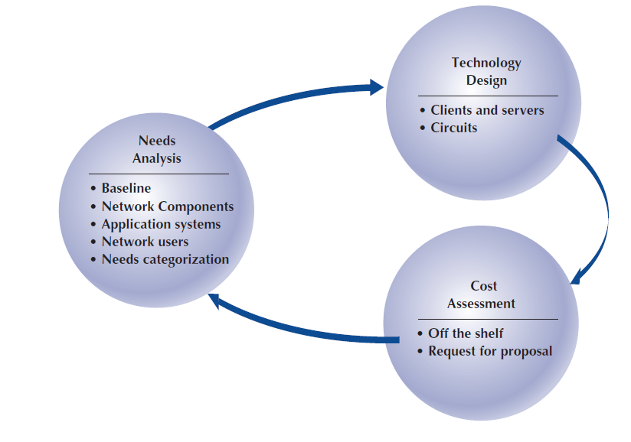

Network Design
Traditional network design
Building-block network design
Needs analysis
Precise estimate of amount of data/user
Circuit need + cost estimate

Slide 5
6.2 Needs Analysis
GOAL:
NETWORK ARCHITECTURE COMPONENTS:
APPLICATION SYSTEMS
NETWORK USERS
CATEGORIZING NETWORK NEEDS
DELIVERABLES

Slide 6
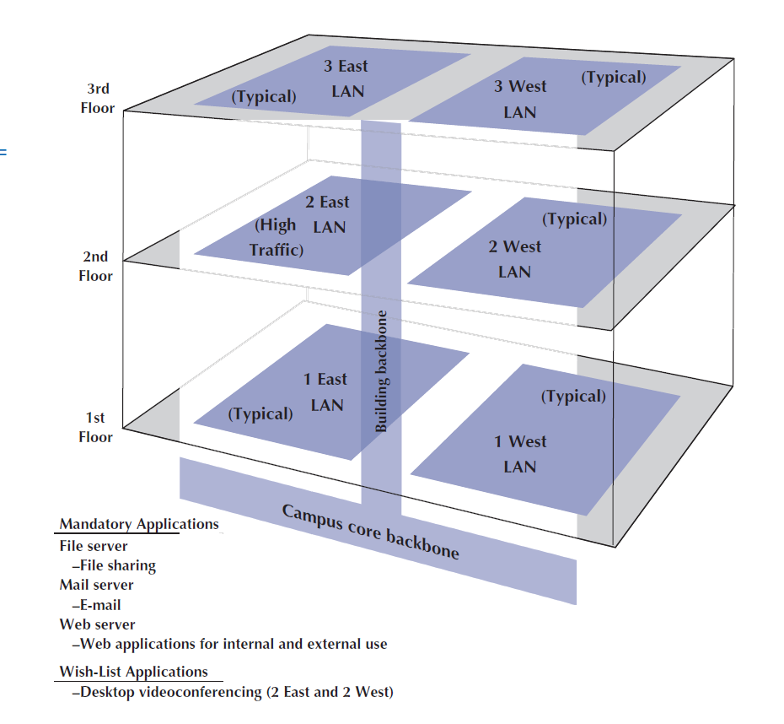
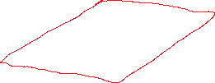
LOGICAL NETWORK DIAGRAM

Slide 7



6.3 Technology Design
CLIENTS & SERVERS
CIRCUITS
Capacity planning
Circuit loading
Bottleneck
look at typical highest-use of network
Copper
Core
fiber

Slide 8
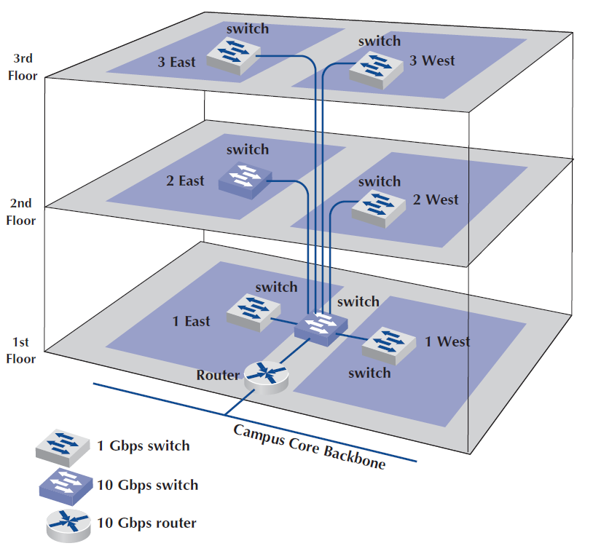

PHYSICAL NETWORK DIAGRAM

Slide 9
6.4 Cost Assessment
Request for Proposal (RFP)
Equipment
Software
Services

Slide 10
6.5 Implications for Cyber Security
Secure each architectural component/module
Enterprise Edge
Security of a building
Don’t forget application security

